Slide 1


Auto Invoice

Slide 2

Agenda
Feature Overview
Setup to Implement the Feature
Invoices with Rules
Determining Dates
EBTax integration
Auto Invoice code flow
Q&A

Slide 3
AutoInvoice Validations
AutoInvoice validates interface data for compatibility with Receivables. It ensures that the columns in Receivables' Interface tables reference the appropriate values and columns in Receivables.
Existence
Batch Sources
Uniqueness
Precision
Cross Validation
Accounting Periods

Slide 4
Invoices with Rules
Accounting rules determine the accounting period(s) in which the revenue distributions for an invoice line are recorded.
Invoicing rules determine the accounting period in which the receivable amount is recorded.
AutoInvoice imports invoices with accounting and invoicing rules if your accounting method is 'Accrual'.
AutoInvoice rejects all invoices with rules if your accounting method is 'Cash Basis' because with Cash Basis Accounting, you only recognize revenue when payment is received. Invoices with rules are therefore not applicable for the Cash Basis method, as they are designed to distribute revenue over several periods before receipt of payment.

Slide 5
Invoices with Rules
Accounting Rules
Fixed Schedule
Specify the Period and number of Periods over which the revenue is recognized.
The revenue is then evenly divided across the periods.
Variable Schedule
Specify the period. Number of periods is provided when creating the transaction.
The revenue is then evenly divided across the periods.
Daily Revenue Rate, All periods
Daily Revenue Rate = Total Revenue / Number of Days (Total Rule Duration Period)
Revenue Amount = Daily Revenue Rate * Days in Period
Daily Revenue Rate, Partial periods
Revenue Amount = Daily Revenue Rate * Days in Period for partial periods.
Remaining amount is equally prorated across full periods.

Slide 6
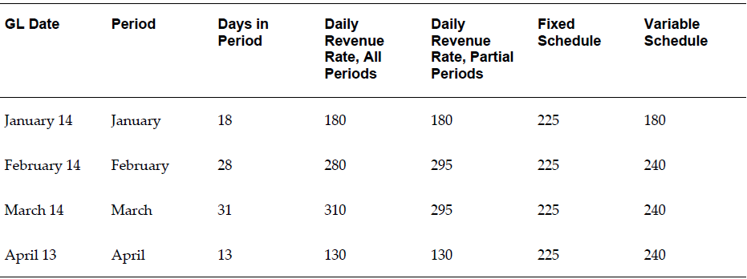
Invoices with Rules
For example, suppose a transaction is created for $900, which starts January 14 and ends April 13 (90 days), and the accounting period is Monthly. In this contract period, January and April are partial periods, and February and March are full periods.

Slide 7
Invoices with Rules
Invoicing Rule
Bill In Advance: Use this rule to recognize the receivable immediately.
Bill In Arrears: Use this rule to record the receivable at the end of the revenue recognition schedule.
Accounting Rule is assigned to a Transaction Line.
Invoicing Rule is assigned to a Transaction.

Slide 8
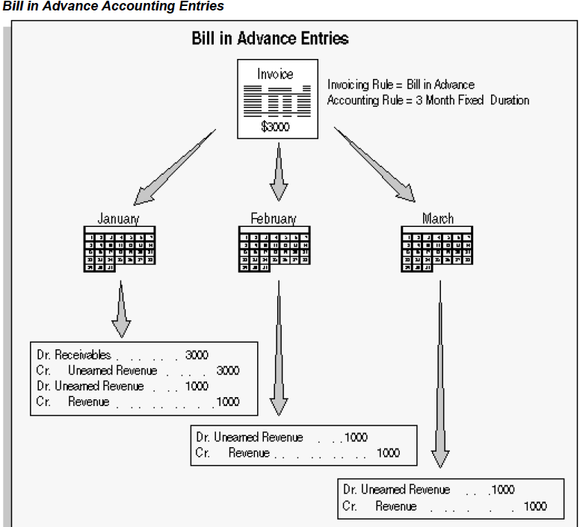
Invoices with Rules

Slide 9
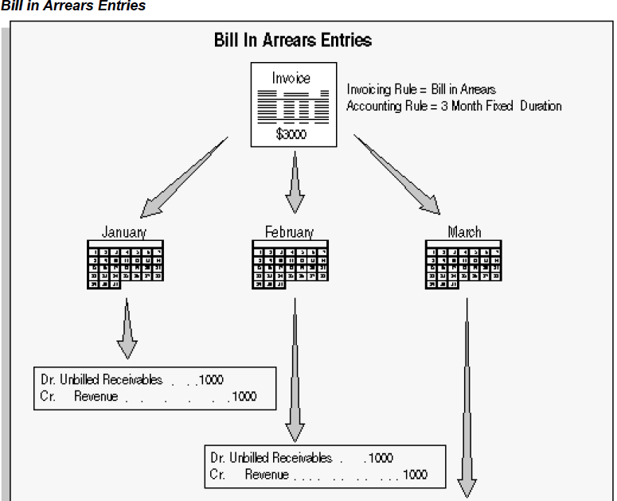
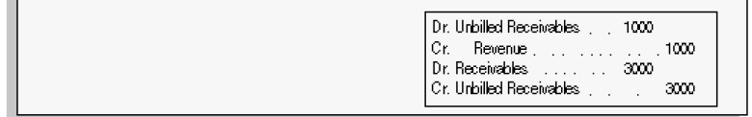
Invoices with Rules

Slide 10
Invoices with Rules
To import invoices with rules, we need to pass Invoicing Rule information, Accounting Rule information, Rule Start Date (optional), Rule Duration (Optional) and Rule End Date (Optional) in the interface table [RA_INTERFACE_LINES_ALL].
Validation for Lines With Rules
Besides validating dates, AutoInvoice also validates and rejects lines if:
The accounting rule has overlapping periods
All of the accounting periods do not exist for the duration of your accounting rule

Slide 11
Credit Invoices with Rules
When a Credit Memo is applied against an Invoice with rules, the account assignments can be adjusted in three ways: LIFO, Prorate, and Unit.
The Last In First Out (LIFO) method backs out revenue starting with the last GL period of the invoice revenue. This method reverses revenue recognition from prior periods until it has backed out an amount of revenue that is equal to the amount of your credit memo line.
The Prorate method credits an equal percentage of all of your invoice's account assignments.
The Unit method lets you reverse the revenue for the number of units you specify from an original line of the invoice.

Slide 12
Credit Invoices with Rules
To import Credit Memos against Invoice with Rules, we need to pass Credit Method for Rules (LIFO/PRORATE/UNIT) in the interface table.
The rule information for the regular credit memo will be defaulted from the invoice
On Account Credit Memos will not have rules.

Slide 13
Credit Invoices with Rules
To import Credit Memos against Invoice with Rules, we need to pass Credit Method for Rules (LIFO/PRORATE/UNIT) in the interface table.
The rule information for the regular credit memo will be defaulted from the invoice
On Account Credit Memos will not have rules.

Slide 14
Determining Dates
AutoInvoice determines the General Ledger date for invoices using the following criteria:
Does a GL date exist for this invoice in the interface table?
Does the invoice use rules?
What is the setting of the Derive Date option for this Transaction Batch Source (Yes or No)?
What is the setting of the GL Date in a Closed Period option for this Transaction Batch Source (Adjust or Reject)?

Slide 15
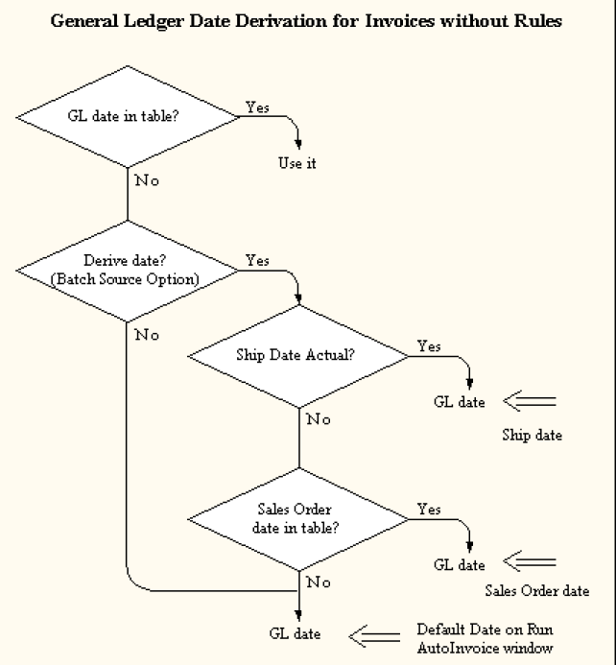
Determining Dates

Slide 16
Determining Dates
General Ledger for Invoices with Rules:
Bill in Advance
AutoInvoice uses the GL date provided in the interface table as the invoice GL date. If no GL date is provided in the interface table, then AutoInvoice uses the earliest accounting rule start date as the invoice GL date.
Bill in Arrears
If the invoice line has an accounting rule of type Fixed Schedule and a period of Specific Date, AutoInvoice computes an ending date using the latest accounting rule date. For all other accounting rules, AutoInvoice computes an ending date for each invoice line based on the accounting rule, accounting rule start date, and duration.
Once AutoInvoice computes the ending date for each line of your transaction, it takes the latest date and uses it as the invoice GL date.

Slide 17
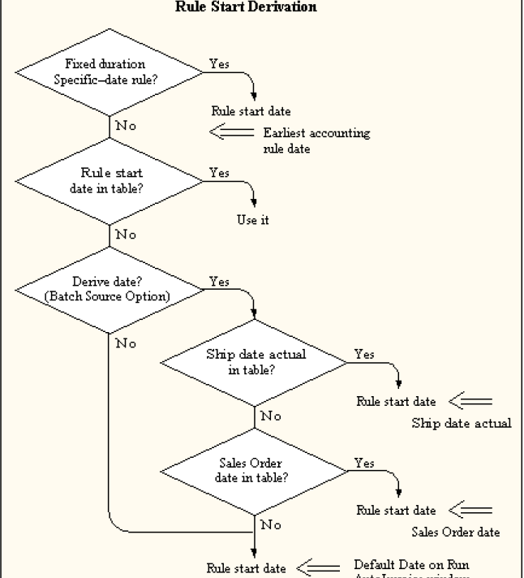
Determining Dates

Slide 18
Determining Credit Memo Dates
If a transaction date is passed for your credit memo, AutoInvoice uses the following hierarchy to determine the credit memo date:
The credit memo general ledger date.
The general ledger date for the invoice's receivable distribution, or the Default Date in the Run AutoInvoice window, whichever is later.
If a general ledger date is not passed, AutoInvoice uses the general ledger date for the invoice's receivable distribution or the Default Date in the Run AutoInvoice window, whichever is later.
If transaction date is not passed for invoice or debit memo, AutoInvoice uses the General Ledger date

Slide 19
Validating Dates
General Ledger Dates
The accounting period for the general ledger date is not defined.
The general ledger date is in a 'Closed,' 'Closed Pending,' or 'Not Opened' period and the GL Date in a Closed Period field for your batch source is set to 'Reject.' (For invoices that use Bill in Arrears rules, AutoInvoice only rejects lines that have a general ledger date in a Closed period.)
The general ledger date of the credit memo is before the invoice general ledger date and/or the credit memo date is before the invoice date.

Slide 20
Validating Dates
Rule Start Dates
The rule start date for lines that used Bill in Advance rules are in 'Closed' or 'Not Opened' periods and the GL Date in a Closed Period field for your batch source is set to Reject, or if the accounting period for the rule start date is not defined.
The rule start date for lines that used Bill in Arrears rules results in a general ledger date in a Closed period and the GL Date in a Closed Period field for your batch source is set to Reject, or if the accounting period for the general ledger date is not defined.
The rule start date is not the earliest date specified for your accounting rule and you are passing an accounting rule with a type of Fixed Schedule and a period of Specific Date.

Slide 21
Adjusting General Ledger Dates
Invoice without Rules
Same as defaulting GL Date [Ship to -> Sales Order -> Default]
Invoice with Rules
AutoInvoice uses the last day of the prior period, if this period has a status of Open.
If a prior period with a status of Open does not exist, AutoInvoice uses the first day of the subsequent period that has a status of Open. However, if there is more than one subsequent period with a status of Open, AutoInvoice cannot adjust the general ledger date, and the line is rejected.
If an Open period does not exist, AutoInvoice uses the first day of the first subsequent period that has a status of Future. If there is more than one subsequent period with a status of Future, or if it cannot find a future period, AutoInvoice cannot adjust the general ledger date, and the line is rejected.

Slide 22
EB Tax Integration
Through AutoInvoice, manual tax lines [Line_Type = ‘TAX’] could be passed.
AutoInvoice also calculates tax based on the Tax setup
Taxable_Flag in the interface table can be used to skip the automatic tax calculation
Tax_Exempt_Flag can be used to pass exemptions. They will be honored only if exemptions are set for customers in EB Tax setup.
In EB Tax, taxes are calculated based on tax codes and place of sale (Location)

Slide 23
EB Tax Integration
AR and EB Tax communicate through GT tables
AR will populate ZX_TRX_HEADERS_GT and ZX_TRANSACTION_LINES_GT. ZX_IMPORT_TAX_LINES_GT will be populated with manual Tax lines passed in the interface table and make a call to EB Tax API to calculate Tax.
EB Tax, in turn, will calculate Tax and populate ZX_LINES table. AutoInvoice will read data from this table and populate Tax lines in RA_CUSTOMER_TRX_LINES_ALL table.

Slide 24
AutoInvoice Master Program
The Master program runs several instances of AutoInvoice to improve system performance and import transactions more quickly.
Auto Invoice groups data by the following combination of values in the interface table and distributes the groups across child processes.
org_id || '~' || batch_source_name || '~' || orig_system_bill_customer_id || '~' || orig_system_bill_customer_ref || '~' || orig_system_bill_address_id || '~' || orig_system_bill_address_ref || '~' || NVL(cons_billing_number, trx_number) || '~' || NVL(cons_billing_number, purchase_order) || '~' || NVL(cons_billing_number, currency_code) || '~' || NVL(cons_billing_number, conversion_type)
The value set for the profile option “AR:Maximum lines per AutoInvoice worker” is considered during load splicing.

Slide 25
AutoInvoice Code Flow
AutoInvoice can be divided into three major phases, pre-grouping, grouping and transfer.
Pre-grouping: In this phase, AutoInvoice validates all of the line-level data and any other data that is not dependent upon successful grouping. Some examples include validating that a transaction type is valid, and validating that only one freight account exist for each freight line passed.
Grouping: In this phase, AutoInvoice groups lines based on the grouping rules and validates header-level data that is dependent on how your lines are grouped. Some examples include validating the over application rules specified for your batch source and validating that the general ledger date of an invoice against a commitment is not before the general ledger date of the commitment
Transfer: In this phase, AutoInvoice validates information that exists in Receivables tables such as tax defaulting and AutoAccounting data.

Slide 26
AutoInvoice Code Flow
Pre-Grouping
Line level validation (parallel unit 0) [Commit]
Sales credit level validation (parallel unit 1) [Commit]
Distribution level validation (parallel unit 2) [Commit]
Default exchange rate
Grouping
Determine Grouping rules and group the data
Transfer
Insert batch data and create transactions, debit memos and Credit
Memos. Regular Credit Memos are created last as they may refer to
other transactions that will get created in the current run.
Submit reports
Mark as validated
Clean up ------------------------------------- [Commit]

Slide 27
Additional Information
Payment Methods and Bank Accounts
Regardless if we are passing manual or automatic receipt methods, AutoInvoice validates that the receipt method belongs to the bill-to customer/site or the parent of the bill-to customer/site, if it has one. Additionally, the receipt method must have at least one bank account in the currency of the transaction or its Receipts Multi-Currency flag must be set to Yes.
Hierarchy
Primary Site for the Parent
Parent Customer
Bill-to-Site for the line
Bill-to-Customer for the line
Customer bank accounts are not used for manual receipt methods.

Slide 28
Additional Information
Correcting AutoInvoice Exceptions
Use the Interface Exceptions window to view all records that failed AutoInvoice validation.
Use the Interface Lines window to update these failed records.
AutoInvoice Reports
Execution Report
This report lists summary information telling you how many revenue and credit transactions are selected, accepted, and rejected for each currency.
Validation Report
This report lists lines that have failed different phases of validation and the error messages associated with these lines.

Slide 29
Code Structure
Src/autoinv directory
Main Files
Master Program: raamtr.opc
Import Program : raamai.oc
Purge Program : raadel.opc
EBTax integration
AREBTAIB.pls
AutoAccounting
ARTEAACB.pls

Slide 30
Debug Logs
PL/SQL debug log follows FND Debug setup
Obtain detailed request log by setting AutoInvoice Message Level to a value more than 3 (10 to see all messages) in the system options
Separate trace files will be generated for Master and Import processes.

Slide 31
Q&A

